Slide 1

FHIR APIs in Healthcare
Moira E. Smith, MD, MPH, FACEP
Data to Decisions: AI in Healthcare
Friday, January 23, 2025

Slide 2
Learning Objectives
By the end of the session, students will be able to:
Explain what FHIR is and why it matters for modern healthcare
Describe how FHIR APIs enable interoperability & AI tools
Understand how EHR data becomes usable for clinical decision support & AI
Recognize current and future clinical use cases

Slide 3
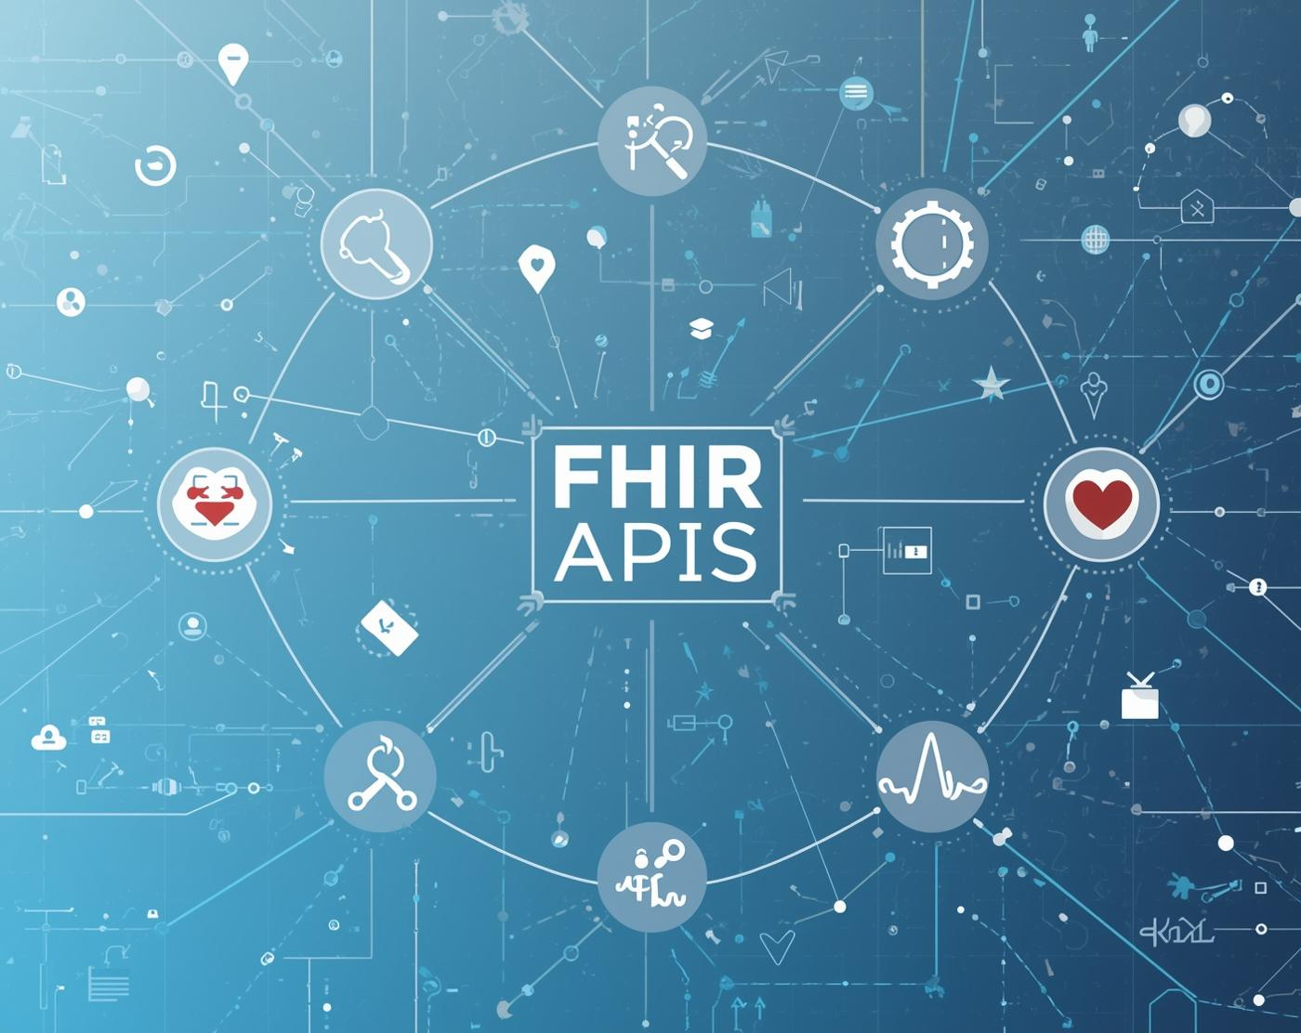
Understanding FHIR APIs in Healthcare
Key Concepts and Architectural Benefits
Exploring FHIR APIs for enhanced healthcare integration

Slide 4

Why Should Physicians Care?
Clinical Framing
Every AI tool, dashboard, CDS system ⟶ depends on data access
Today’s medicine = software-mediated care
FHIR is the language that makes healthcare data usable
Labs, medications, vital signs, notes ⟶ AI models
Order sets, alerts, risk scores ⟶ built on APIs

Slide 5

What is FHIR?
FHIR = Fast Healthcare Interoperability Resources
A modern standard for exchanging healthcare data

Slide 6
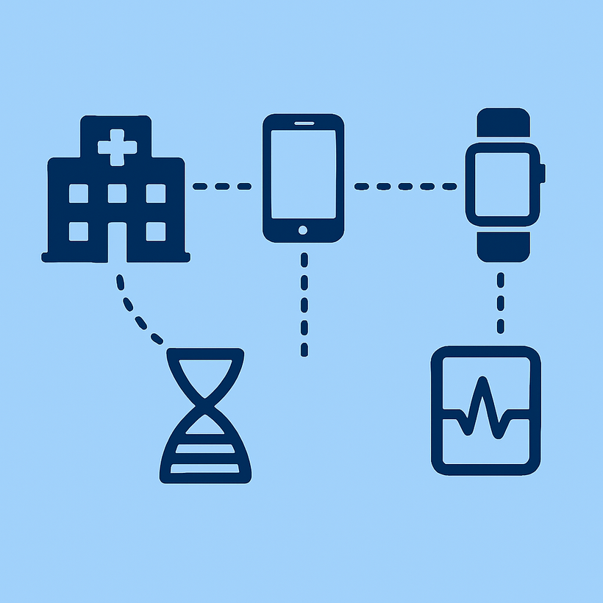
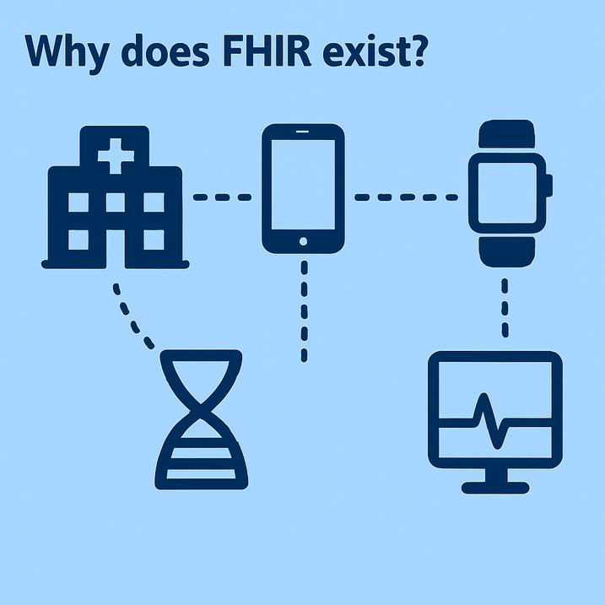
Why does FHIR exist?
1980s - Interoperability in healthcare began
To connect systems WITHIN a hospital itself - not between hospitals
Now data in many places besides the hospital
Payers have multiple systems
Patients have mobile devices, home devices, wearables
Genomic sequencing labs
1980s: 10 facts per complex decision
2020: ~1000 facts per complex decision
Individual can handle 5 facts on average
HL7 Task Force
To create a healthcare data standard from scratch

Slide 7
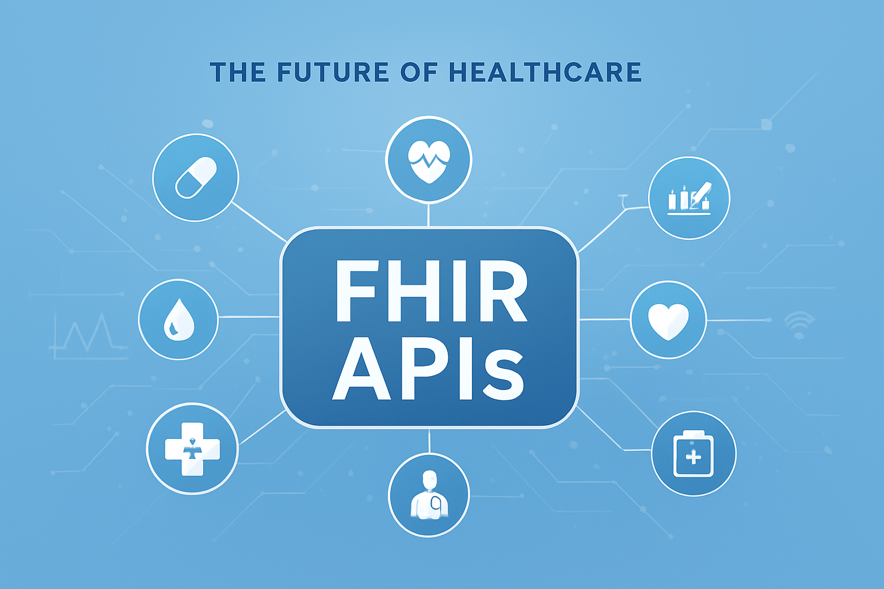
The Problem FHIR Solves
Old World
HL7 messages
PDFs, faxes, proprietary systems
New World
Real-time data
Apps
Interoperability
AI-ready information

Slide 8
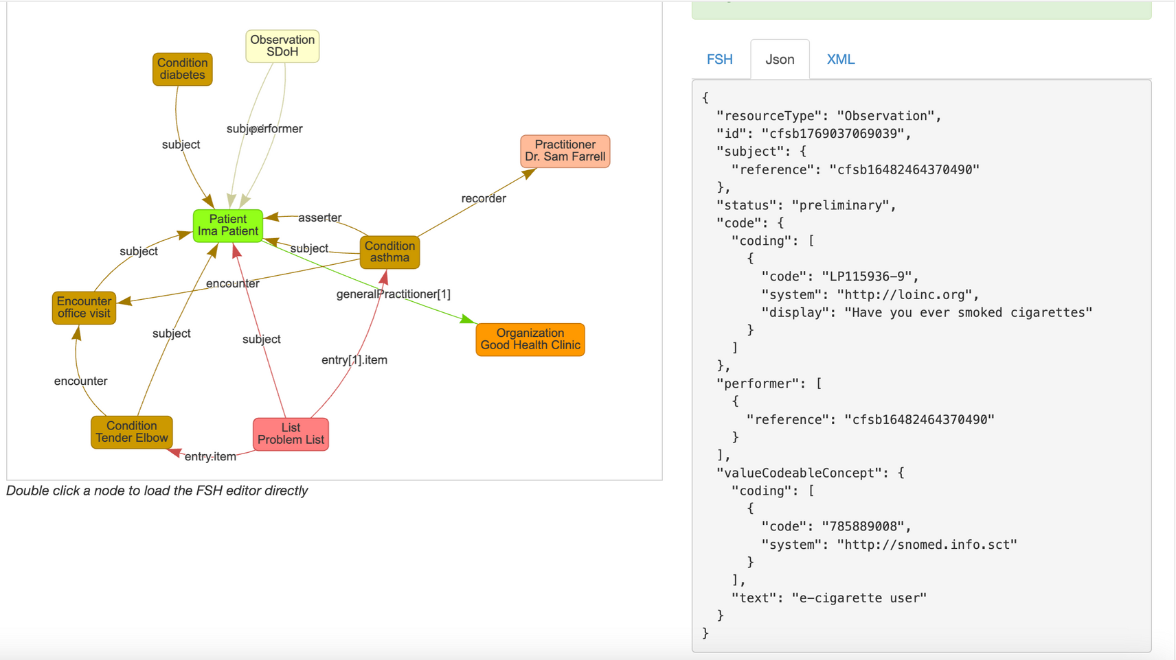
FHIR Resources
FHIR breaks the medical record into standard building blocks:
Patient
Observation
Medication
Encounter
Condition
Procedure
LEGO blocks of healthcare data

Slide 9

What is an API?
Application Programming Interface
A URL-based way to access clinical data
⟶ allows two different software programs to communicate with each other and exchange data
Examples
Google maps
Paypal
Social media
Weather apps
Travel booking

Slide 10

Security Considerations
Ensuring safe use of FHIR APIs

Slide 11
Security Concerns
Authentication and authorization mistakes
Overbroad scopes
Confusing “authentication” with “authorization”
Weak client authentication
Data exposure and privacy leakage (even when “working as designed”)
1) Who gets in
2) What they’re allowed to see
3) What happens to the data afterward
FHIR resources can expose sensitive diagnoses
Metadata leaks
Search/query leakage
Third-party app ecosystem risks
Downstream storage
Data minimization failures
Re-identification risk

Slide 12
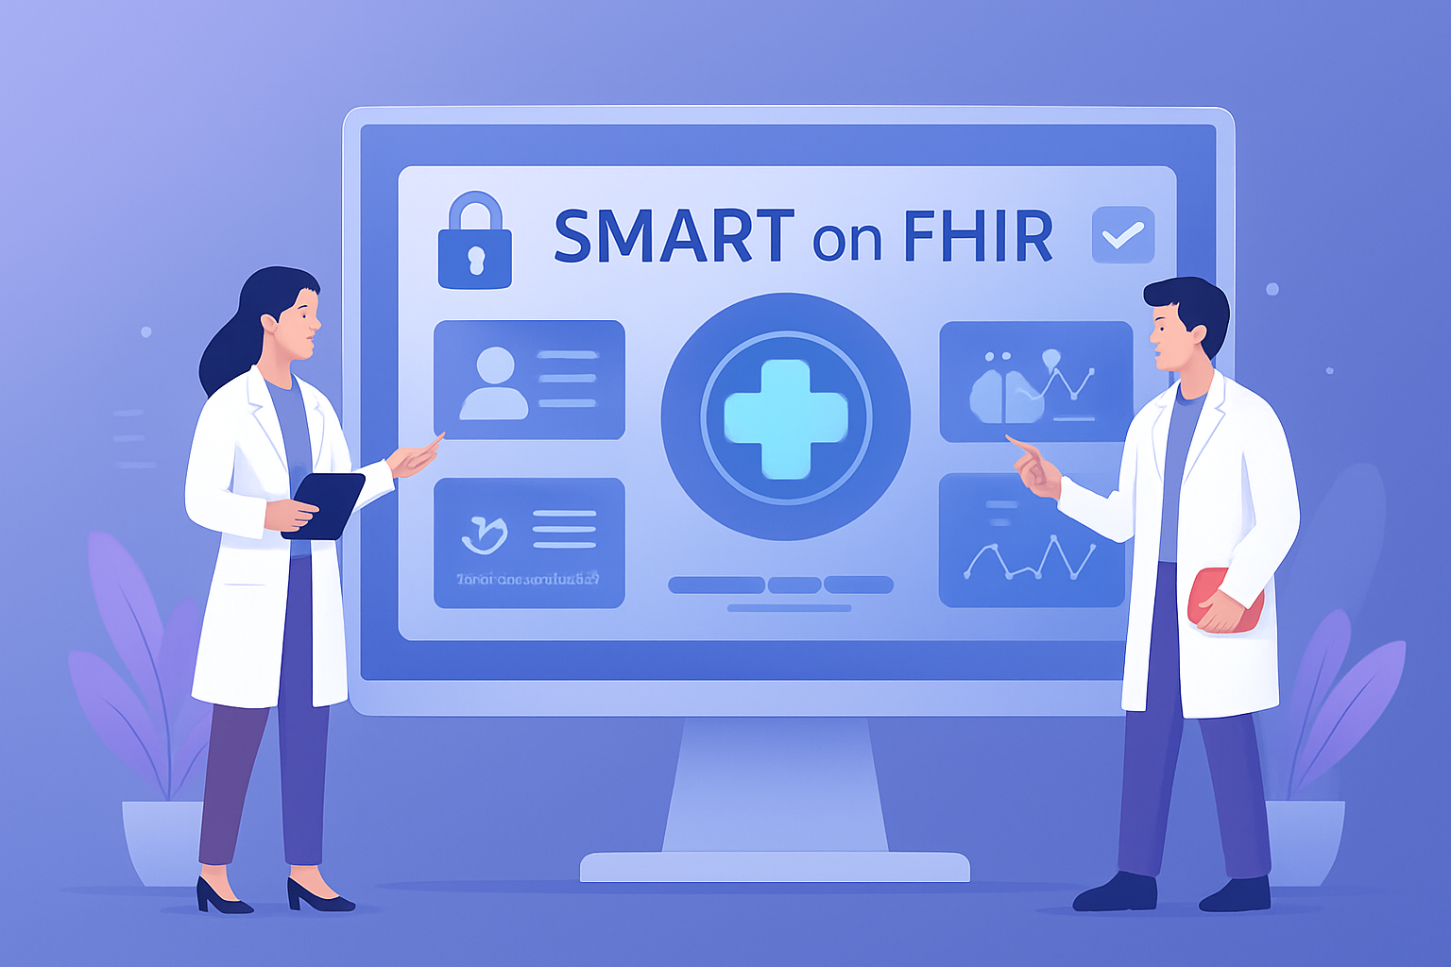
SMART on FHIR
Substitutable Medical Applications, Reusable Technologies
Open standard that lets healthcare apps securely access and exchange data from Electronic Health Records (EHRs) and other systems
Provides:
Secure login
App authorization
Permission control

Slide 13

Building a FHIR Data Architecture
In-Class Exercise
https://learning.intersystems.com/course/view.php?id=2525

Slide 14
Case: Chest Pain in the ED
A 62-year-old male presents with chest pain.
Vitals, labs, ECG, meds, and past history are automatically retrieved via FHIR into an AI-based decision support tool.
The tool calculates:
30-day MACE risk: 18%
Suggests: “Activate high-risk chest pain pathway”
Discussion Questions
What FHIR data elements were likely used?
How would missing or incorrect data affect this output?
Would you trust this tool? Why or why not?
Who is responsible if the AI is wrong?

Slide 15
Knowledge Check
1. Which FHIR resource would contain a patient’s potassium result?
A. Condition
B. Procedure
C. Observation
D. Encounter
2. Why is FHIR important for AI development?
A. It improves billing
B. It reduces documentation burden
C. It makes healthcare data computable and interoperable
D. It replaces clinicians
3. What does SMART on FHIR provide?
A. AI model training
B. Clinical decision rules
C. Security and authentication
D. Data storage

Slide 16
Knowledge Check
4. Name one potential risk of AI in medicine related to data.
5. In your clinical experience, which workflow could most benefit from FHIR-enabled AI tools?

Slide 17

Wrap-Up & Career Relevance
Final Takeaways
FHIR is the plumbing of digital medicine
AI depends on interoperable, high-quality data
Clinicians who understand this will shape the future
Career Tie-In
Clinical informatics
Digital health
AI research
Health system leadership

